Slide 1
What impact have post crisis public policies had on gender equality in EU member States?
Beijing + 20 Seminar
Anjelica Finnegan
FEPS YAN Gender & Crisis Working Group

Slide 3
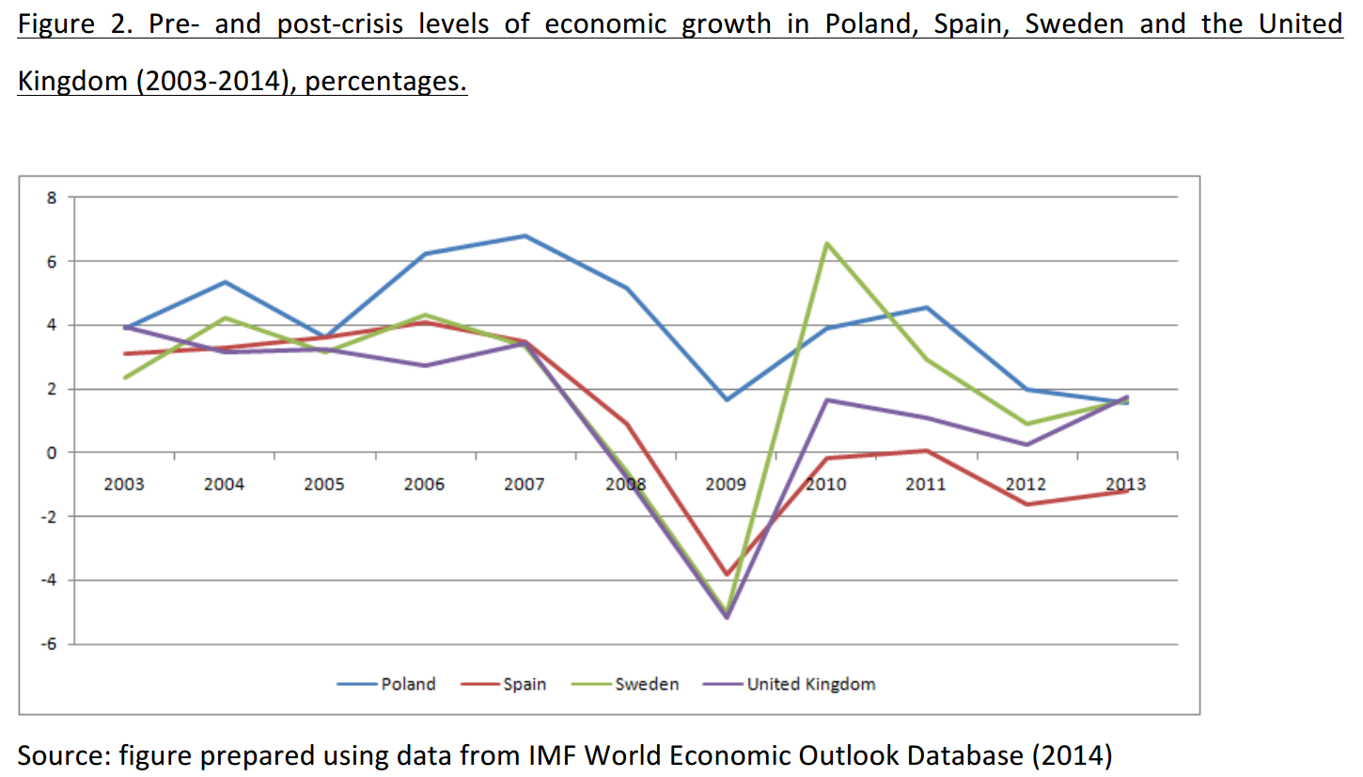

Slide 4
Inequality between men and women has grown since the financial crisis
Unemployment
Poverty and Social Exclusion
Gender pay gap

Slide 5
Unemployment (mean unemployment figures for men and women by regime type (2000-2013)

Slide 6
Poverty and Social Exclusion

Slide 7
Gender Pay Gap

Slide 9
Thank you for listening
@anjelicaseason
Anjelica.finnegan@gmail.com

