Slide 1
Delivering Social Europe through a modern Social Model
Kristian Weise
Barcelona
14. March 2014

Slide 2
Twin challenges to Nordic Welfare Societies
- On one hand, the present version of a modern social model risks becoming a hindrance to progress
- On the other hand, the European dimension – i.e. the EU’s influence on the social model – risks further pushing the Nordic model away from its Nordic characteristics
Notes:
Min. For sunhed og forebyggelse (ikke kun noget dårligt)

Slide 3
The issues at stake:
- Internal pressures for reform: changinge the logic of the state, moving from welfare states to competition states
- External pressures: not just globalisation but also EU-rules on internal market and freedom of movement, not least the social dimension and principles of non-discrimination (perhaps more mental and emotional than material for the time, but nevertheless the main issues for debate and possible changes)
Notes:
Min. For sunhed og forebyggelse (ikke kun noget dårligt)

Slide 4
The competition state
From welfare state to competition state
- Not a new idea but developments under way for decades
From protection to mobilisation
From compensation to prevention
From redistribution to increased motivation
From universalism to means-testing
Notes:
Min. For sunhed og forebyggelse (ikke kun noget dårligt)

Slide 5
The competition state
Possible consequences:
- Undermining social contract
- Increasing inequality
- Changing the moral foundation of the state and the understanding of humanity, less trust
- The goal is to safe the welfare society but what kind of society is saved?
Notes:
Min. For sunhed og forebyggelse (ikke kun noget dårligt)

Slide 6
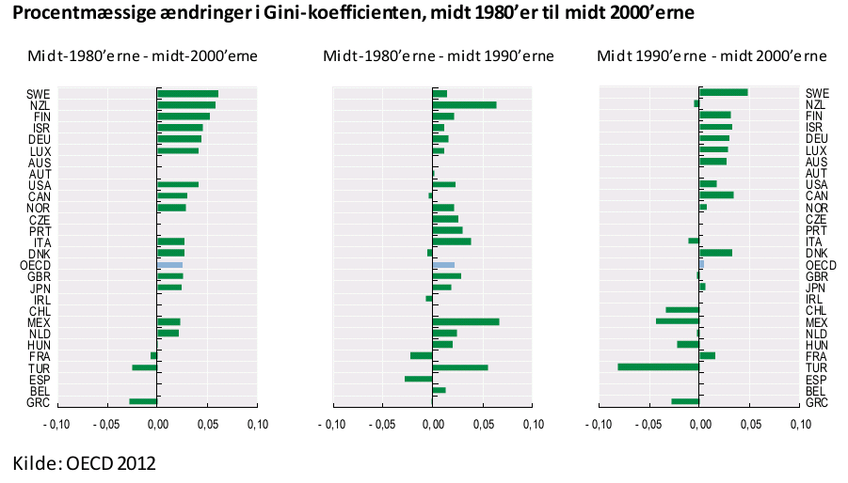
Increased inequality
Notes:
Min. For sunhed og forebyggelse (ikke kun noget dårligt)

Slide 7
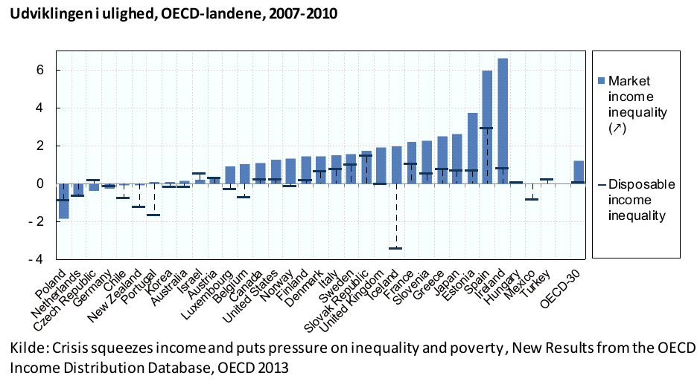
Increased inequality
Notes:
Min. For sunhed og forebyggelse (ikke kun noget dårligt)

Slide 8
The European dimension
The talk of the town:
- Unpleasant names: social tourism, welfare tourism, poverty tourism
- Social rights to workers from other countries, from day one in the country and the possibilty to provide them to kids and families not living in the working-country
- Determinately not obeying with EU-legislation and provoking EU court cases
Notes:
Min. For sunhed og forebyggelse (ikke kun noget dårligt)

Slide 9
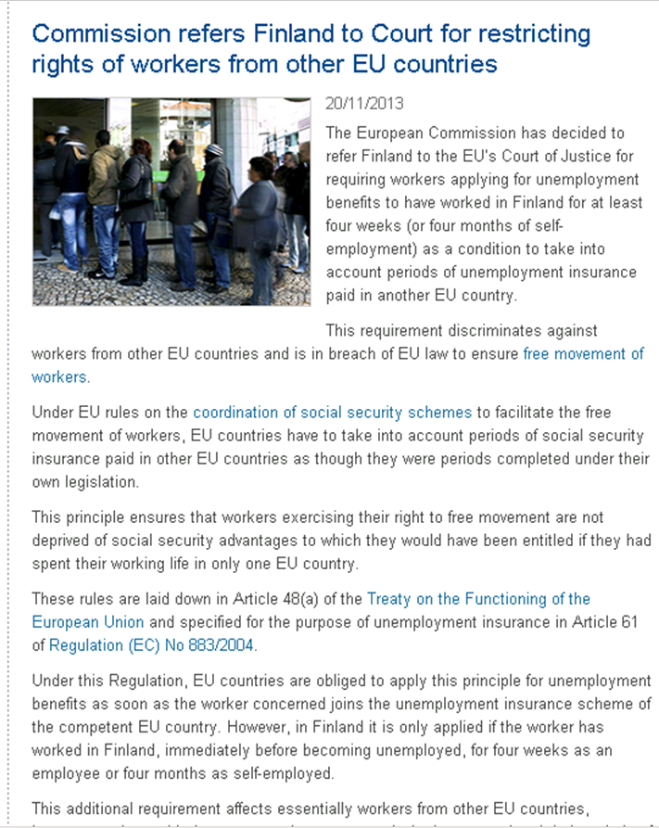
The European dimension
Notes:
Min. For sunhed og forebyggelse (ikke kun noget dårligt)

Slide 10
The European dimension
Why is it an issue? Imagined case in relation to ‘child benefits’.
- Normal salary of workers in Denmark: 3.000-4.000 € a month before taxes
- Salary offered for foreign workers by companies not resepction collective agreements: 1.500 – 2.000 € month before taxes
- Value of ‘child benefits’ received to children in home country: e.g. 3 children at different age gives (200 + 155 + 125 €) 480 € after taxes
Notes:
Min. For sunhed og forebyggelse (ikke kun noget dårligt)

Slide 11
The European dimension
Possible consequences:
- Pitting countries against each other as well as workers from different countries against each other
- Promoting social dumping by employers through the use of social benefits as de facto part of the wage
- Changes of the welfare models – increased race to the bottom
in size, i.e. less welfare overall
in scope, i.e. from universality to self-contribution and self-insurance
- Determinately not obeying with EU-legislation and provoking EU court cases
Notes:
Min. For sunhed og forebyggelse (ikke kun noget dårligt)

Slide 12
Universalism
The short version:
“Everyone receives. They receive the same. And what is received is adequate.”
Levels of universalism:
Definition of ”everyone” (territory, situations)
Definition of ”reveiving the same” (diferences within country, residuality, more corporative systems etc.)
Definition of ”adequate” (middleclass standards)
Notes:
Min. For sunhed og forebyggelse (ikke kun noget dårligt)

Slide 13
Universalism
Residual policies -> few covered (often the weakest/”deviant”) -> negative moral judgement -> experience of stigma
Universal policies -> many covered (including stronger/”the ordinary”) -> absence of negative moral judgement -> absence of stigma
Advantage for the people receiving the benefits and welfare. Advantage for ”takeup rates”.
Notes:
Min. For sunhed og forebyggelse (ikke kun noget dårligt)

Slide 14
So what to do?

Slide 15
New Nordic welfare narrative and fundamental starting point
- If there is no real Social Democratic alternative we will continue to make reforms along neoliberal lines
New compromise of or answer to European dimension of welfare and social benefits
- If status quo is mainted or the issues isn’t taken serious by the left it will lead to general weaking of welfare
Notes:
Min. For sunhed og forebyggelse (ikke kun noget dårligt)

